Slide 1
Business Model
  Cost-effective, long-term partnership with continuous updates and assistance.
  Per-copy Licensee fees with Pre-payment cover service during product lifetime
  (Per-copy Licensee fees are payable only after the total shipped units exceed the prepayment amount)
Service :
Seamless Support from Concept to Production: Engage with us from initial design through to mass production.
Strategic Hardware Design Consultation:
Gain valuable insights and recommendations at the early design stage.
Optimized Audio Architecture:
Receive expert guidance and evaluation to refine your audio path.
Performance Evaluation & Tuning:
Ensure superior quality with preliminary assessments and fine-tuning.
Targeted Hardware & Software Enhancements: Benefit from in-depth analysis, modification suggestions, and rigorous testing.
ITU-T/CarPlay Certification Assistance:
Ease ITU-T and CarPlay certification processes with pre-test and analysis.

Slide 2
A&W SW ECNR
Highlights
Our SW ECNR solution meets ITU-T and CarPlay certification requirements, ensuring exceptional voice quality in both automotive and consumer applications.
Designed to adapt to various noise environments, room sizes, and in-car acoustics, our expertise in fine-tuning ensures audio quality.
With early-stage evaluation, we help customers assess their hardware and audio architecture to optimizes audio path for minimizing latency and improve performance.
Proven in the automotive sector and expanding into consumer electronics, our solutions deliver crystal-clear communication.
Features
Multi-Array Mics
Stereo AEC
ITU-T/CarPlay Compliant
Acoustic Echo Canceller
  Fast convergence
  Convergence in double talk and high noise
  Long echo tail(500ms)
Residual Echo Suppressor
Noise Reduction
  Noise suppression with high frequency resolution
  Fast noise adaptation
Automatic Gain Control
Limiter
  Soft limiter to prevent signal from clipping
Frequency equalizer
  For both RX and TX path
Supported sampling rate:
  8kHz, 16kHz, 24kHz, 32kHz, 48kHz
Processing latency:
  64ms for RX/TX round-trip delay
Resources usage
Sample Rate (khz) | CPI(MCPS) | Code(KB) | RAM(KB)
8 | 97 | 255 | 102
16 | 165 | 255 | 187
24 | 235 | 255 | 270
32 | 281 | 255 | 342
48 | 348 | 255 | 406
Note: Measured on NXP iMX8 mini Cortex A53 with AEC/NR/RX process on

Slide 3
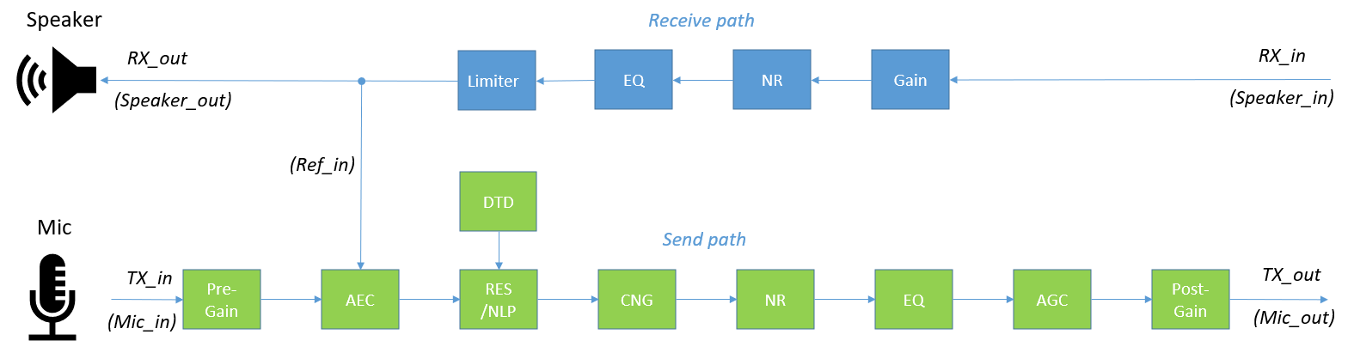
Fine-Tuning Audio for Optimal Performance
Fine-tuning of ECNR is critical for achieving crystal-clear voice communication. Our Tuning Tool empowers engineers to quickly and precisely optimize parameters based on key factors such as:
Microphone Positioning
Adjust for the best placement to minimize echo and maximize clarity.
Mic & Speaker Characteristics
Account for frequency response, sensitivity, and directional properties.
Room Size & Environment
Optimize settings for different spaces, from compact car to full-sized Van or small office to large conference rooms.
Material Impact
Compensate for acoustic reflections from walls, glass, or soft furnishings.
Tuning Tool
Visual GUI tuning
Off-line simulation to get the results after tuning
GUI functional blocks consistent with actual speech processing flow
AEC: Acoustic Echo Canceller
RES: Residual Echo Suppressor
NLP: Non-linear Processing
DTD: Double Talk Detector
CNG: Comfort Noise Generator
NR: Noise Reduction
EQ: Frequency Equalizer
AGC: Automatic Gain Control
LIM: Level Limiter

Slide 4
Ensuring Superior Audio Quality & Performance
We utilize our in-house ITU-T testing tool to verify audio quality and performance, ensuring compliance with ITU-T and CarPlay Certifications. By simulating real-world conditions, we assess echo cancellation, noise reduction, and speech clarity. This not only guarantees optimal audio quality but also streamlines the certification process, reducing both development time and cost
Most Critical test cases for CarPlay Certification:
  RTD(Round Trip Dealy)
  Sensitivity Frequency response
  Loudness Ratings
  Speech Quality During Single Talk
  Idle Channel Noise
  Out-of-band signals
  Echo Performance without BGN
  Double talk Performance
  Speech quality in the presence of BGN
  Absolute noise level
  DTMF cancellation

Slide 5
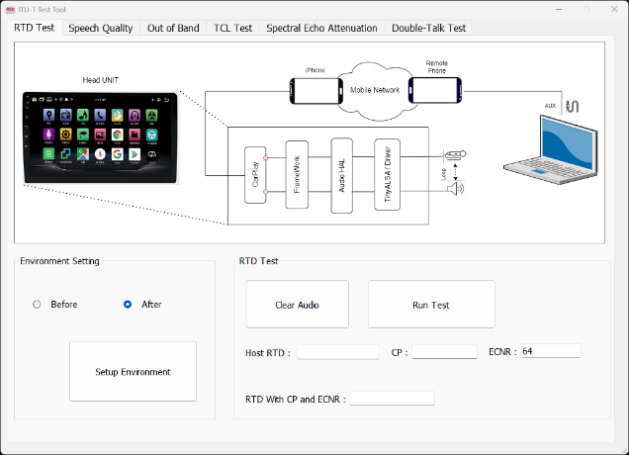
In-House ITU-T Testing Tool
Round Trip Delay
Key Influencing Factors
  Audio Framework Path / Speed
  Bulk Delay
Challenges
  Android system Wireless: < 415ms
A&W Advantages / Countermeasures
  Audio Framework Path Optimization
  Lower Latency : System RDP < 350ms

Slide 6
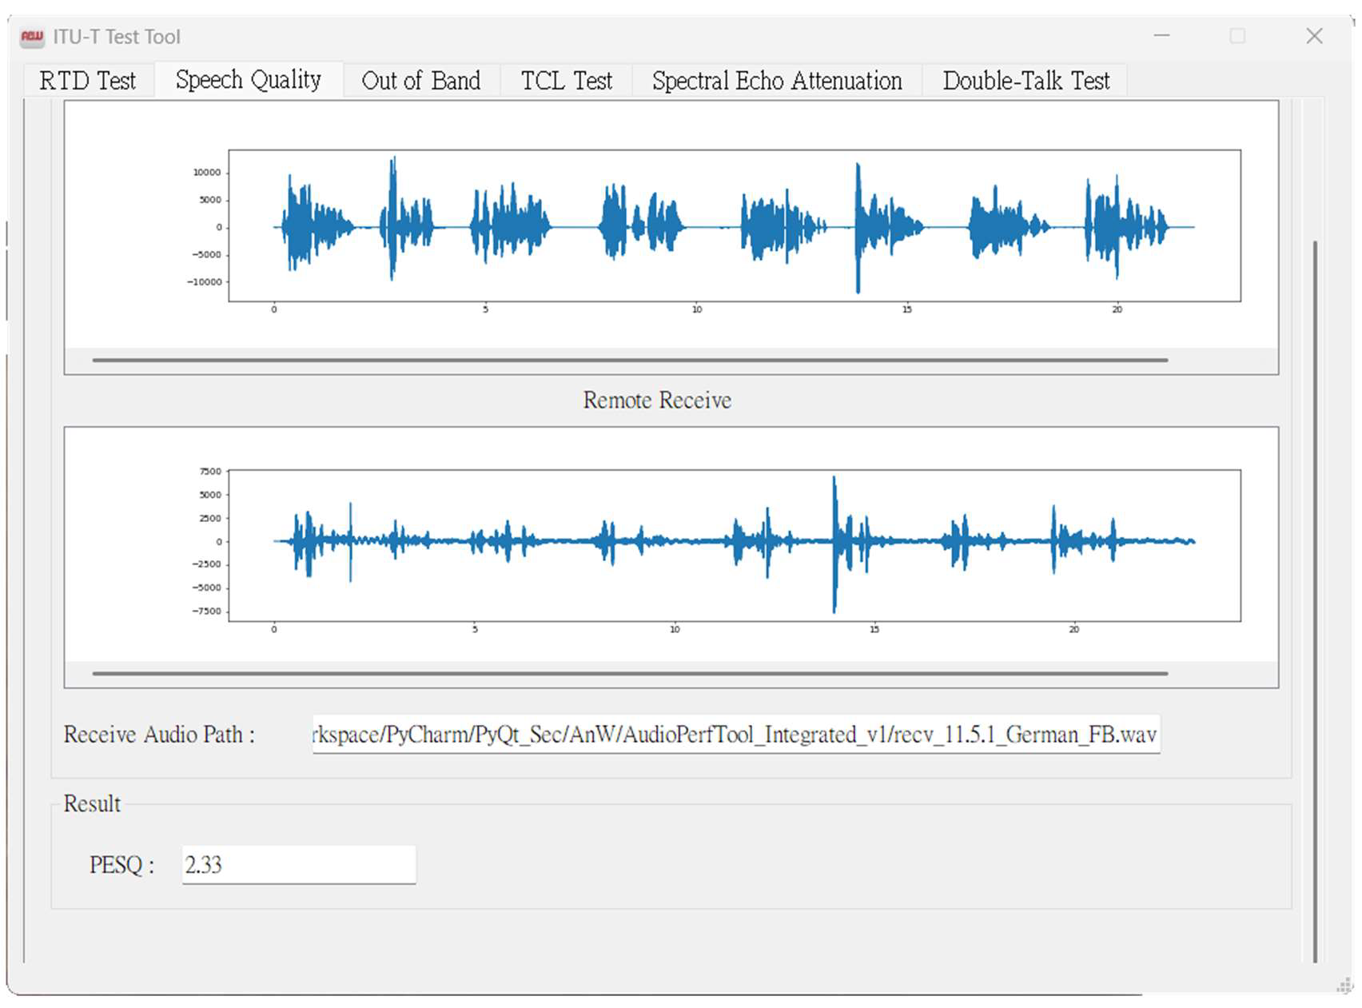
In-House ITU-T Testing Tool
Speech quality in the presence of BGN
Key Influencing Factors
  Noise, e.g., engine noise, A/C, Wind noise, rain sound, fan noise…
  Each metric affects one another, the noise is close to human voices, the noise is extremely loud, making it very difficult to calibrate.
Challenges
  11.13 Background noise transmission
    BGNT Level, Lombard Effect Factor
    EN Speech Quality BGN GMOS
    Check Noise Quality EN NMOS
    Check Speech Quality EN SMOS
A&W Advantages / Countermeasures
  The ECNR algorithm effectively manages noise processing
  High-quality calls can be ensured even in very noisy environments, without a noticeable drop in sound quality due to extracting voices from loud background noise.

Slide 7
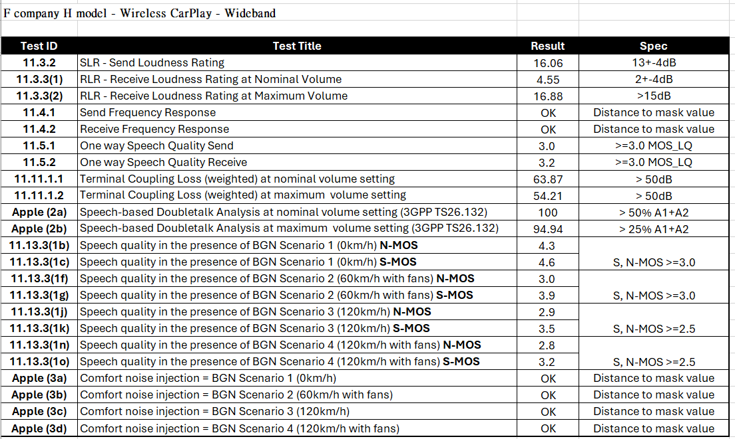
Test Results
Wideband Speech for Wireless CarPlay

Slide 8
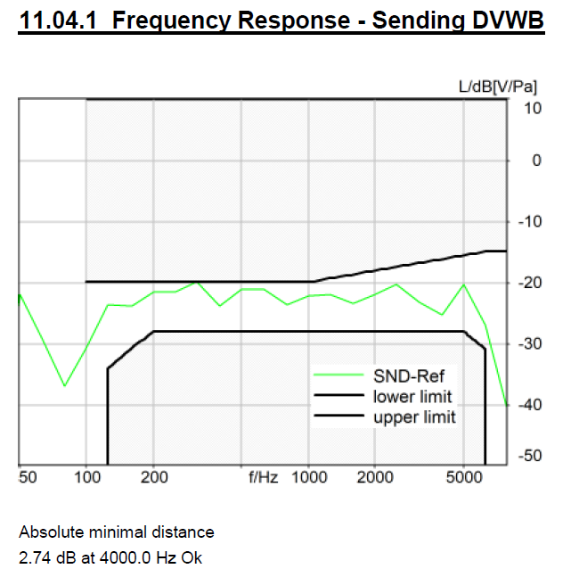
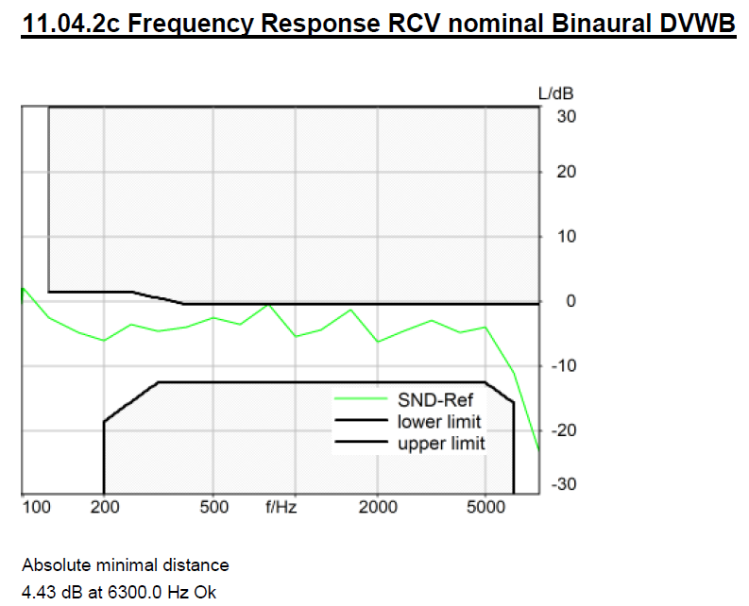
Test Results
Wideband Speech for Wireless CarPlay

Slide 9
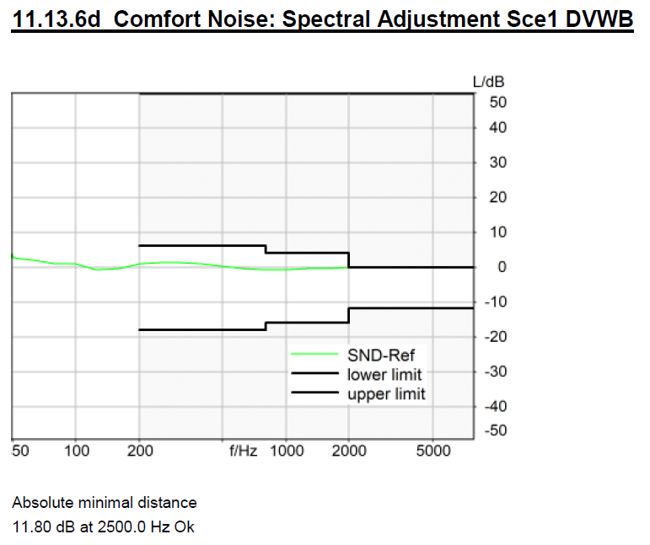
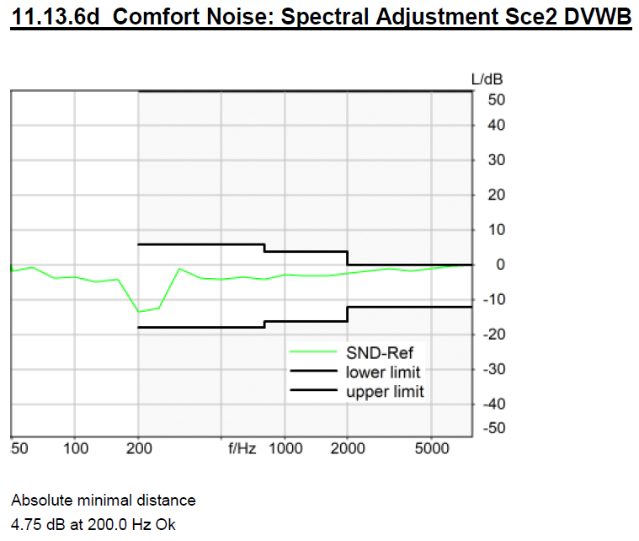
Test Results
Wideband Speech for Wireless CarPlay

Slide 10
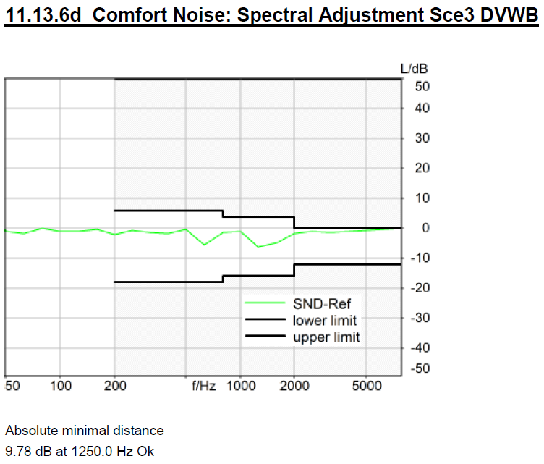
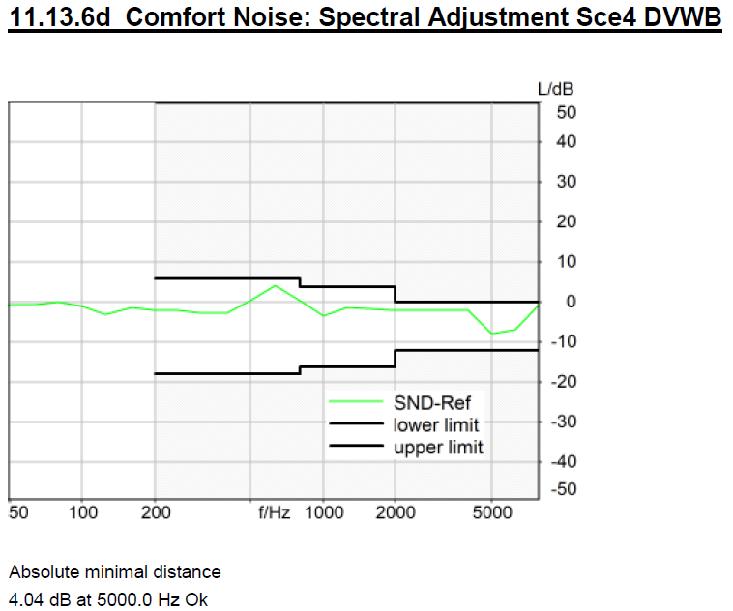
Test Results
Wideband Speech for Wireless CarPlay

Slide 11
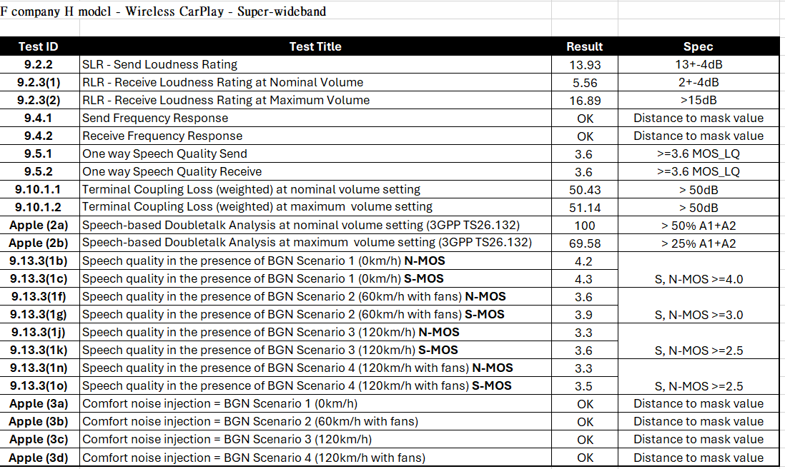
Test Results
Super-Wideband Speech for Wireless CarPlay

Slide 12
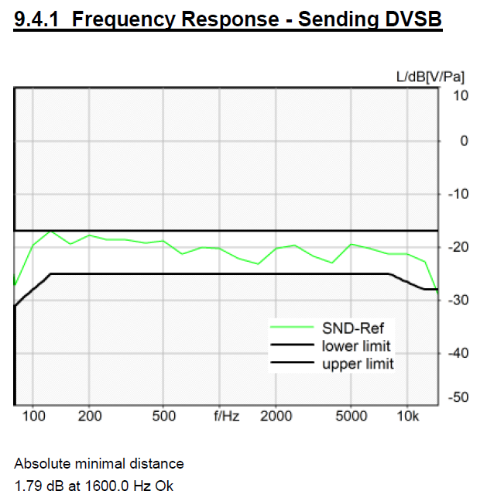
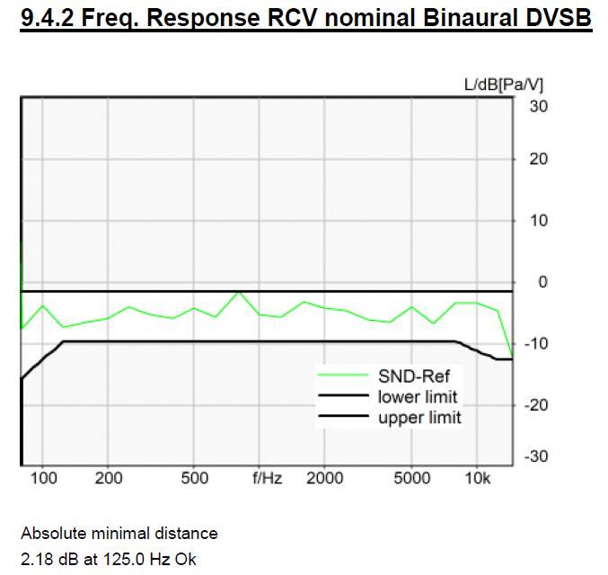
Test Results
Super-Wideband Speech for Wireless CarPlay

Slide 13
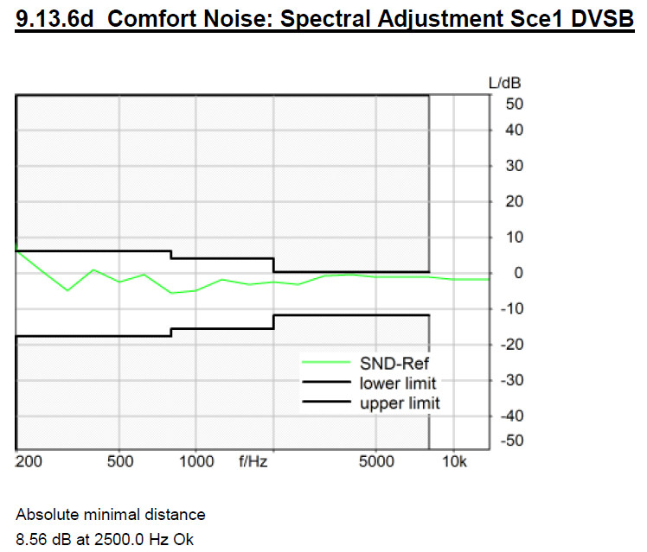
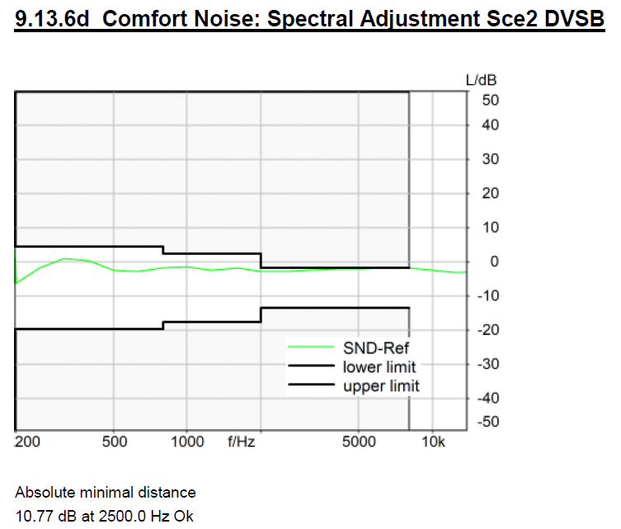
Test Results
Super-Wideband Speech for Wireless CarPlay

Slide 14
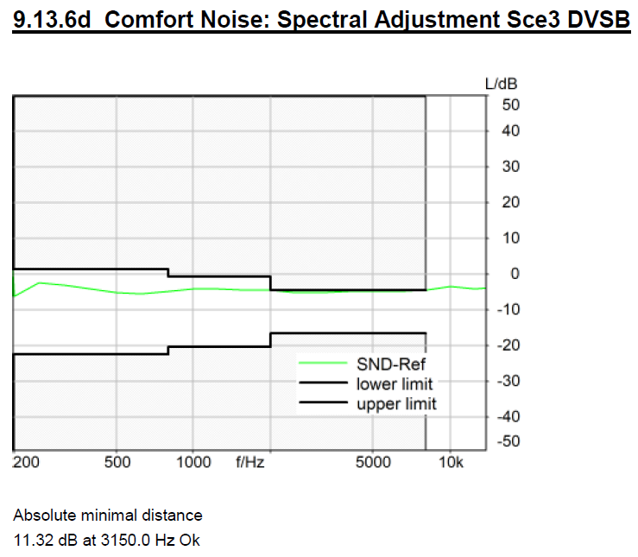
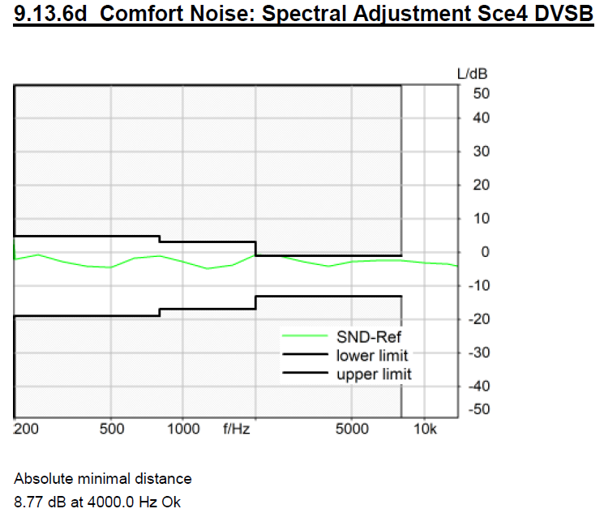
Test Results
Super-Wideband Speech for Wireless CarPlay

Slide 15
Test in a real car
(Suzuki Terios)

Slide 16

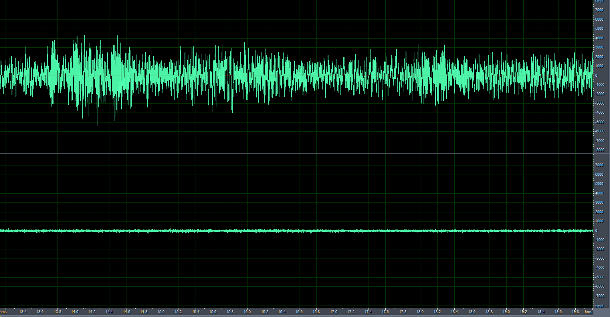
Car speed 60km case
-single talk
Before:
After:
real car test (Suzuki Terios), car speed 60km/hr
Before
After

Slide 17
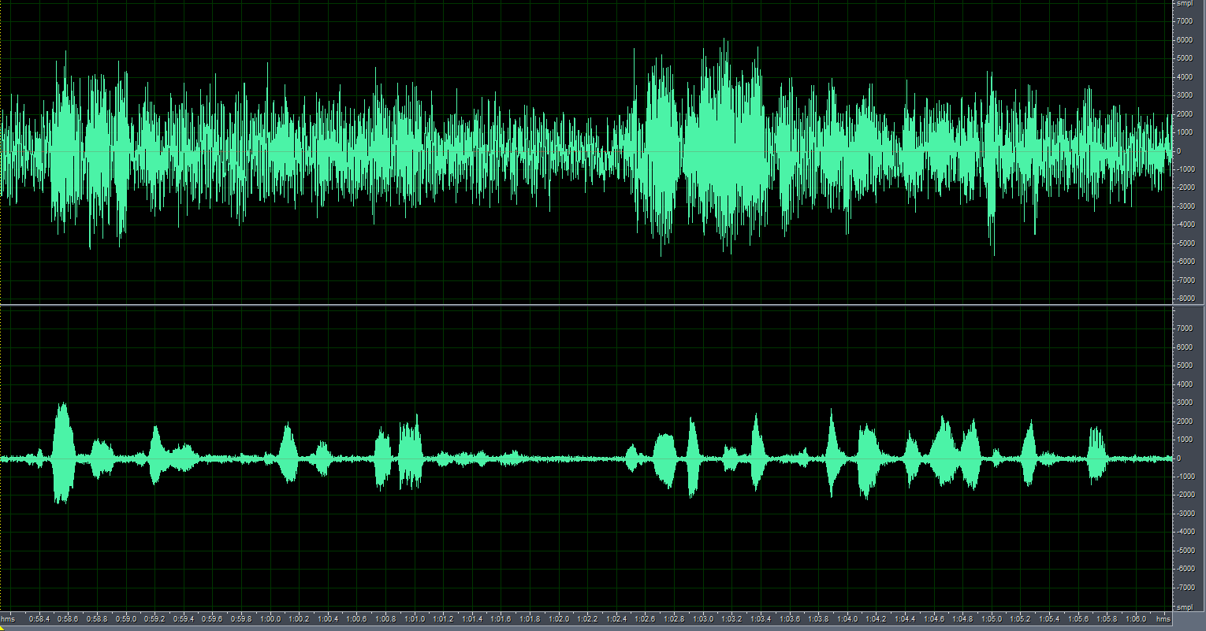
Car speed 60km case
-double talk
Before:
After:
real car test (Suzuki Terios), car speed 60km/hr
Before
After

Slide 18
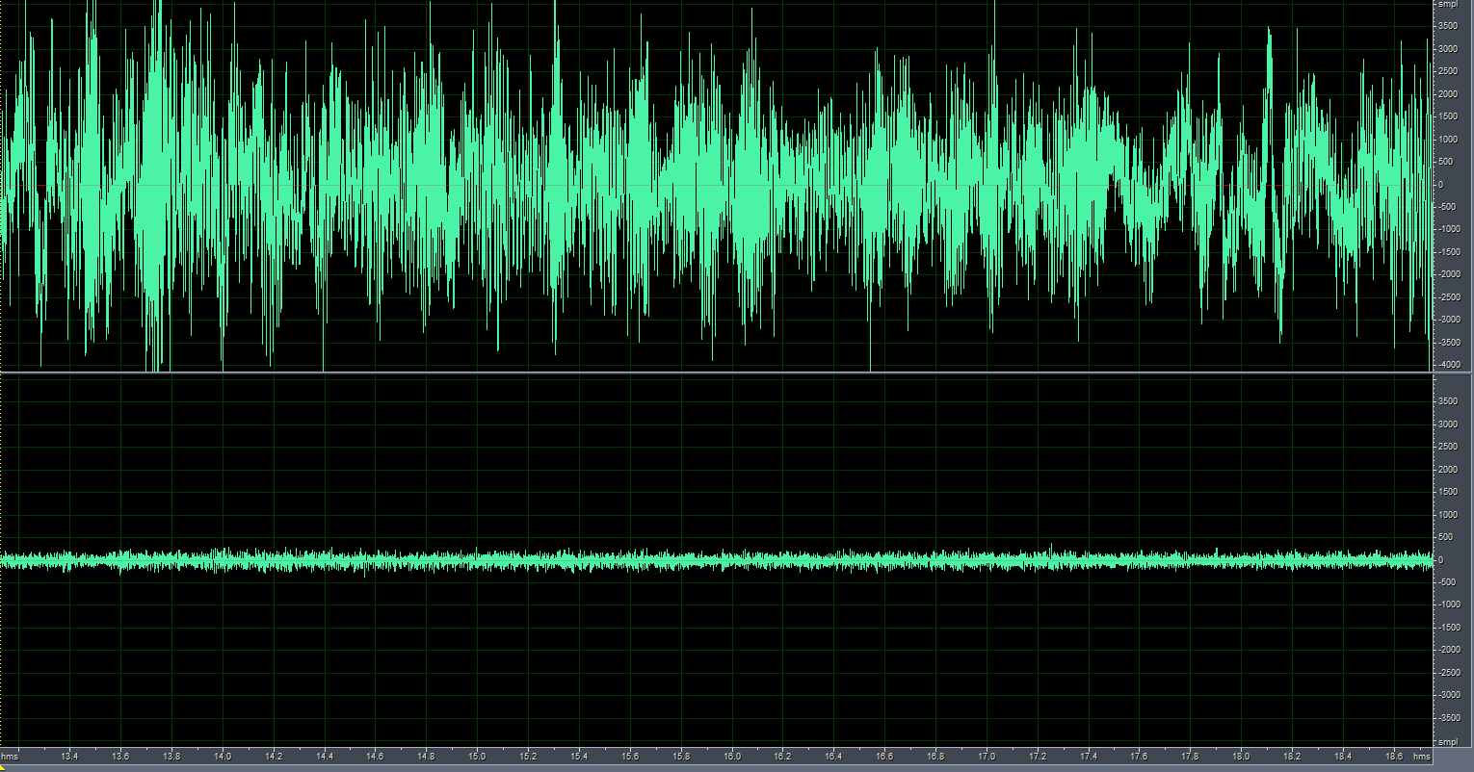
Car speed 120km case
-single talk
Before:
After:
real car test (Honda CRV), car speed 120km/hr
Before
After

Slide 19
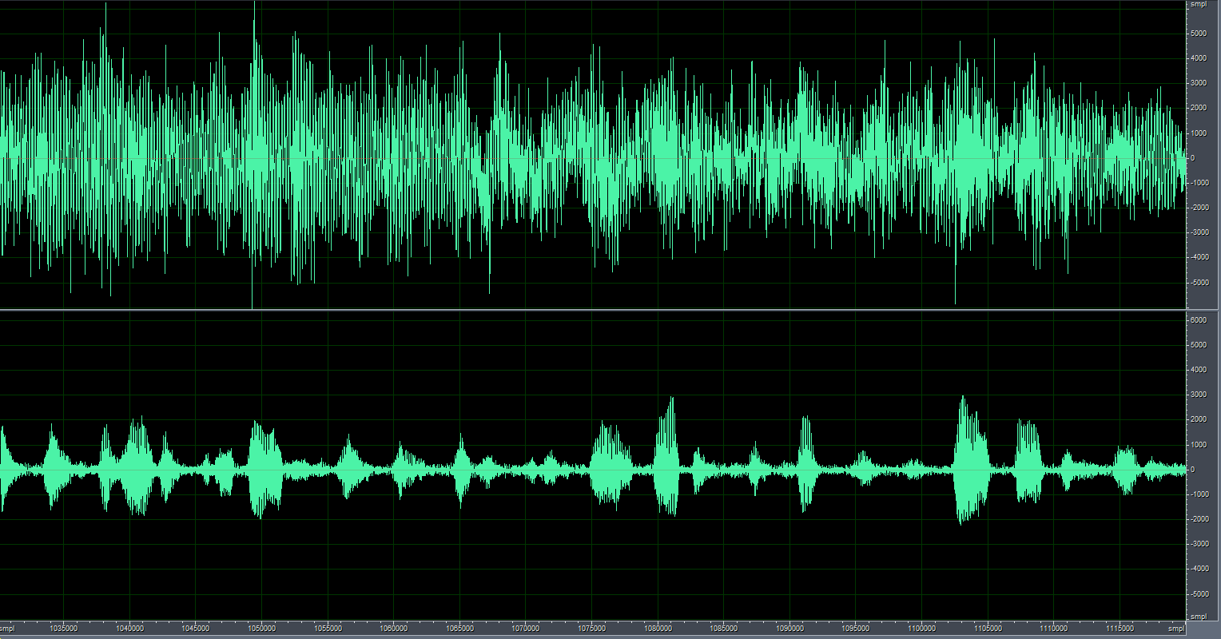
Car speed 120km case
-double talk
Before:
After:
real car test (Suzuki Terios), car speed 120km/hr
Before
After

Slide 20
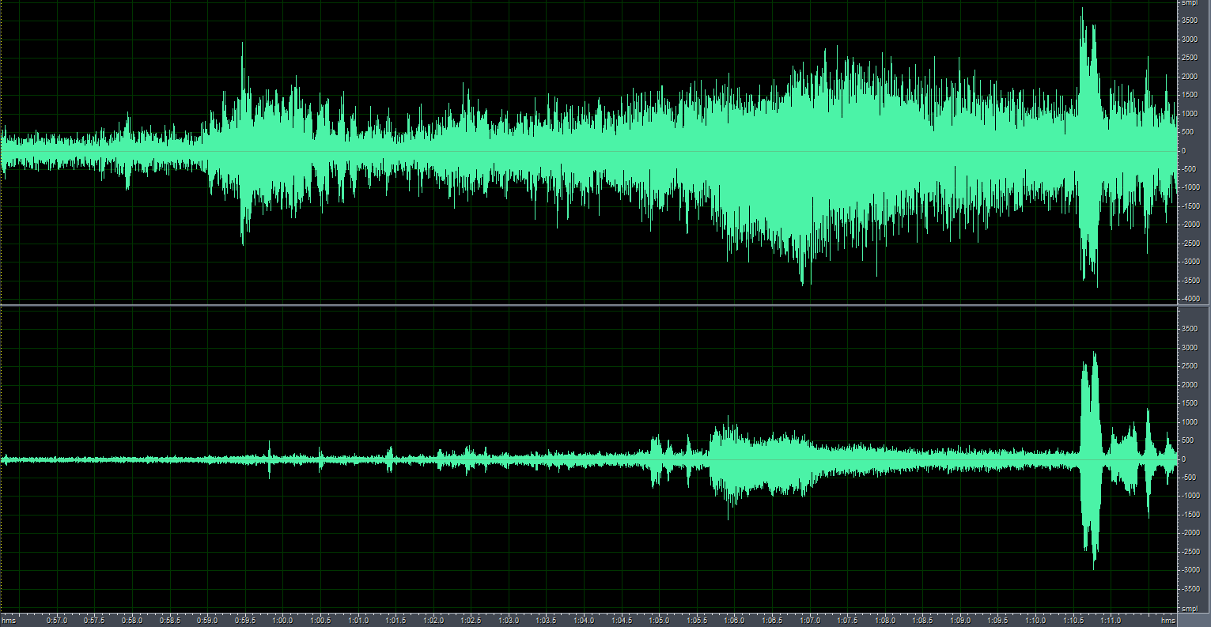
Speed up case
Before:
After:
real car test, car speed from 50km/hr , then speed up to 110km/hr, noise reduction -15dB
Before
After
speed up start

Slide 21
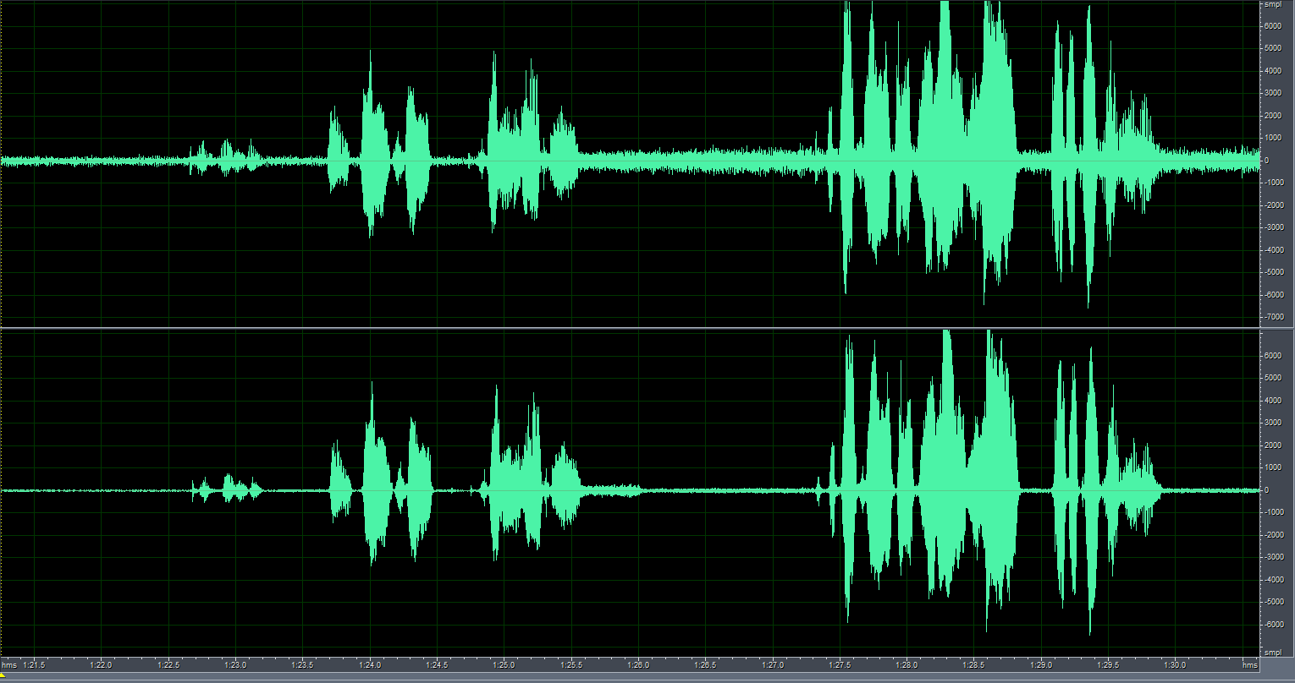
Roll down window case
Before:
After:
real car test, car speed 0km/hr, noise reduction -15dB
Before
After
roll down window time
converge time about 0.4 sec

